Slide 1
A machine learning based classification system for brain signal analysis: an animal model application – Early July progress
By Joshua Mckone

Slide 2
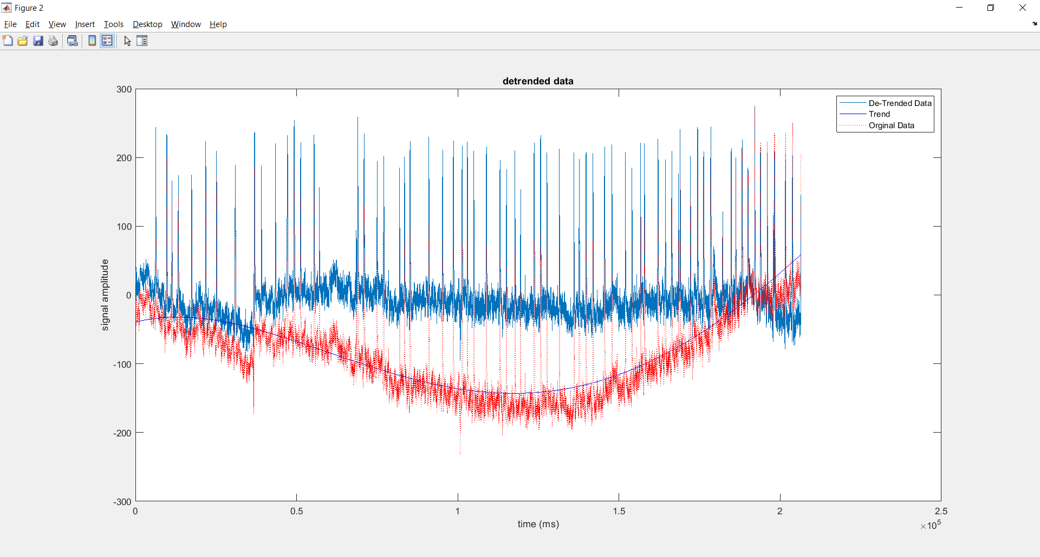
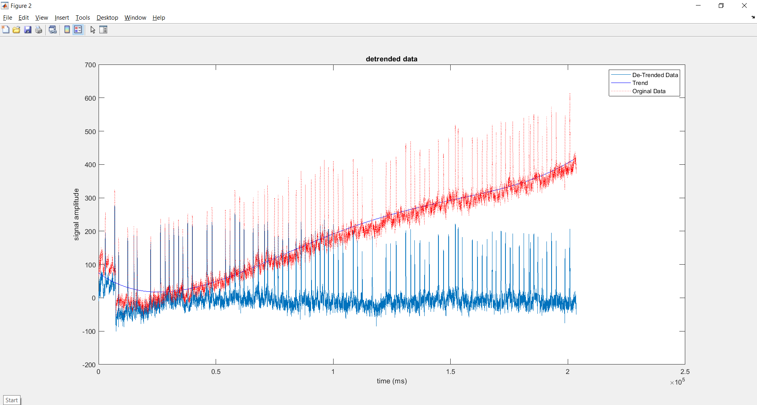
Data Detrending
Signal-wise – for the full dataset a 4 point polynomial is the best result
Each of the signals display some form of fluctuation / trend that doesn’t appear to be part of the data
(dataset 1 (top) dataset 2 (bottom)) first channel

Slide 3
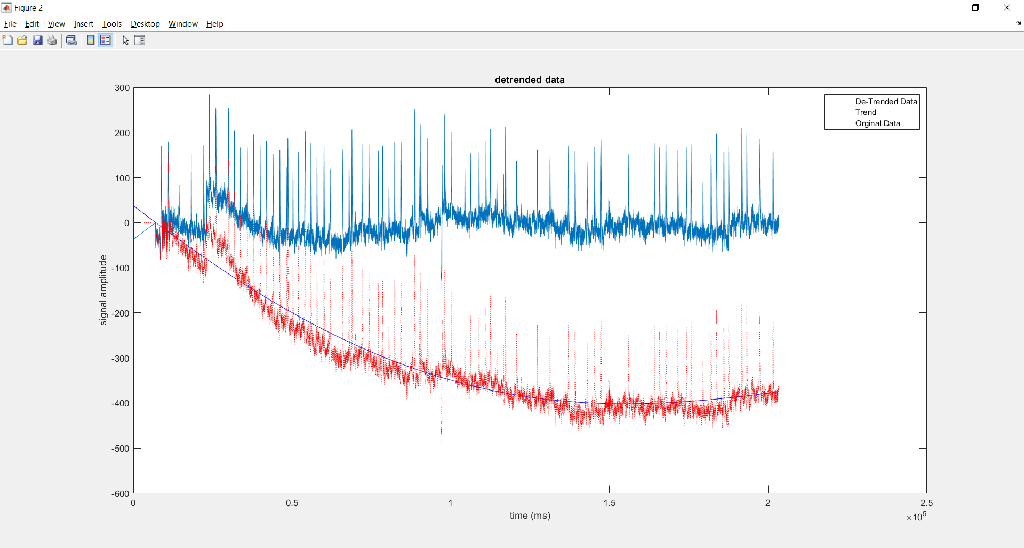
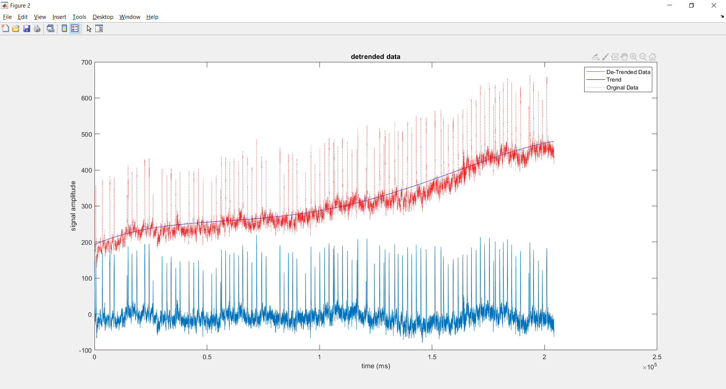
Data Detrending
Dataset 3 (top) required the first 7000 elements to be set to 0 because of how out of the norm they were (in the 2000 – 3000 amplitude)
Dataset 4 (bottom)
Each one only displaying the first channel

Slide 4
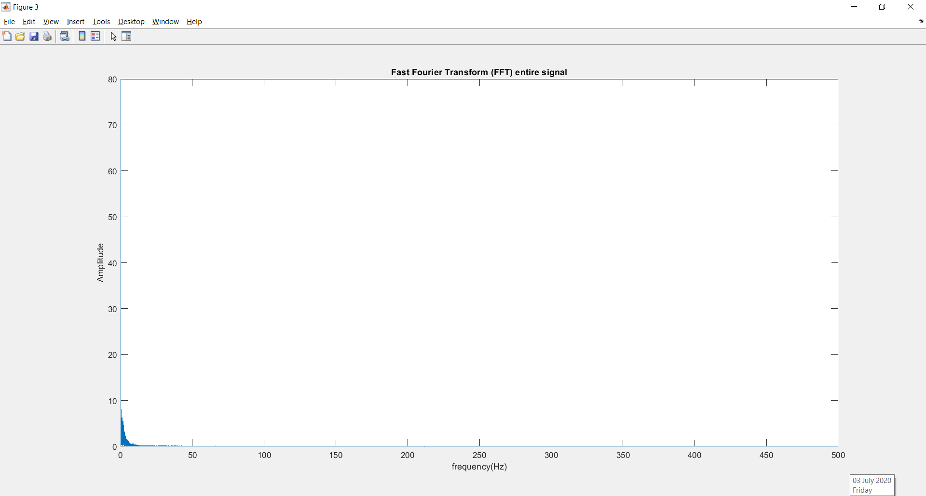
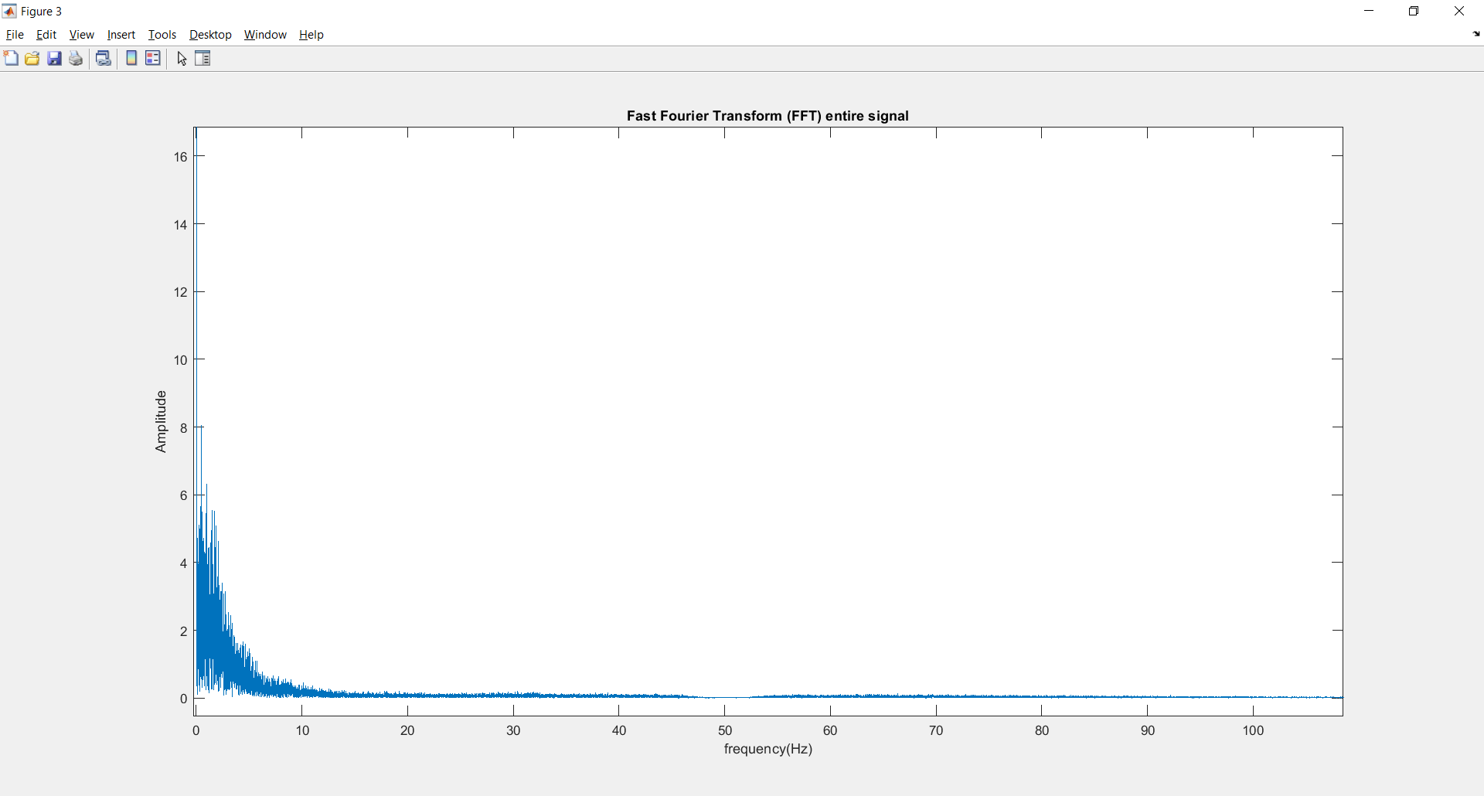
Whole Signal FFT
Signal 1 FFT
Top - full output
Bottom - zoomed in

Slide 5
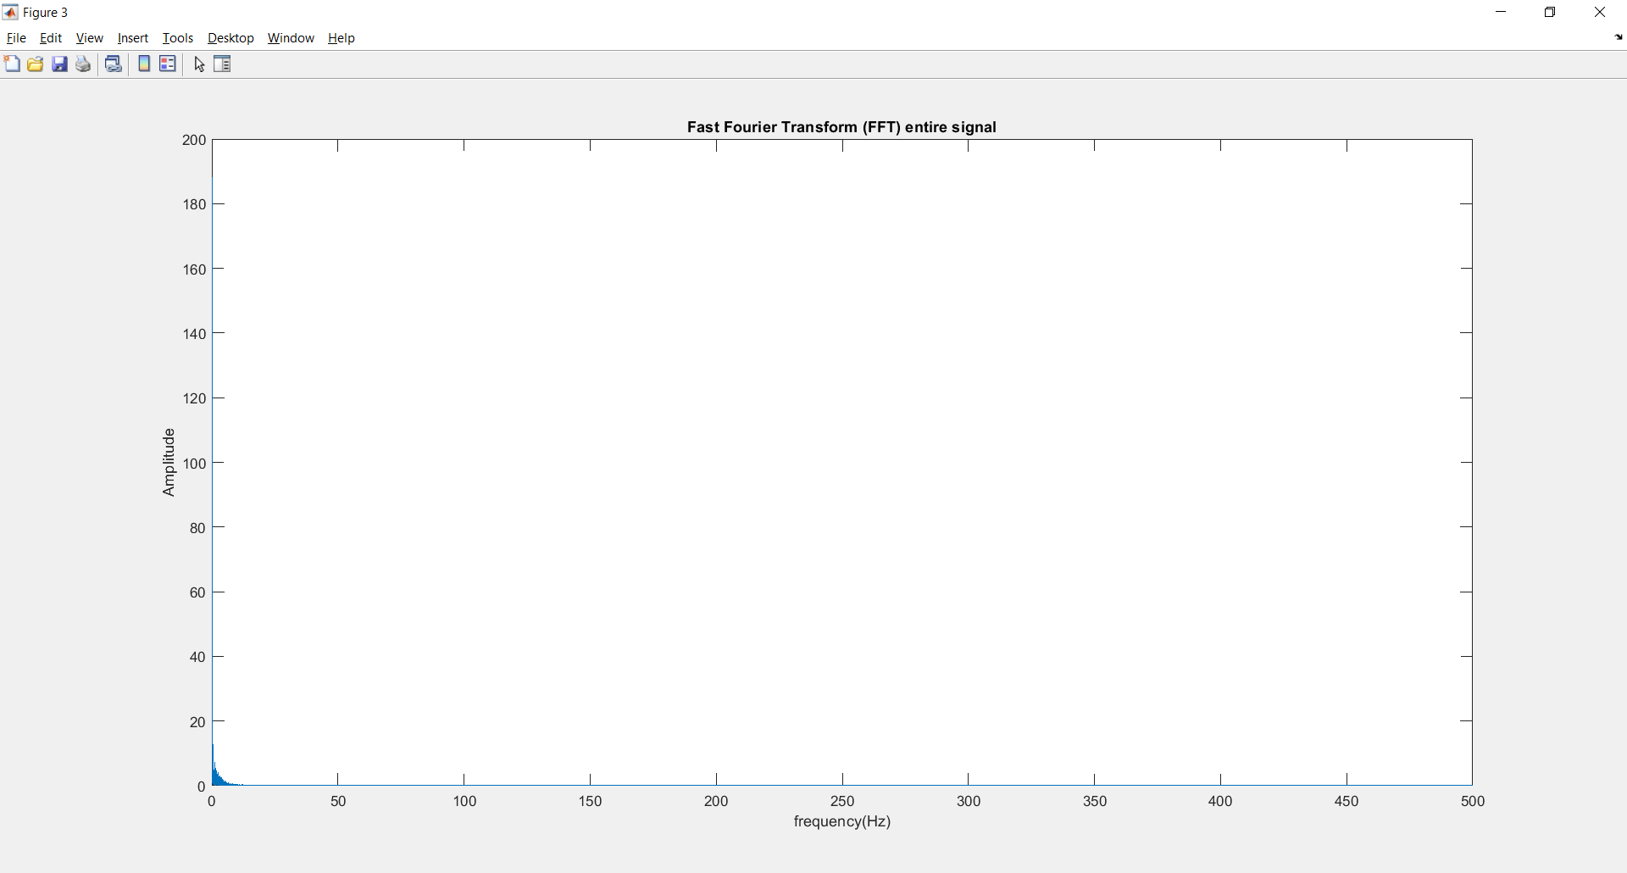
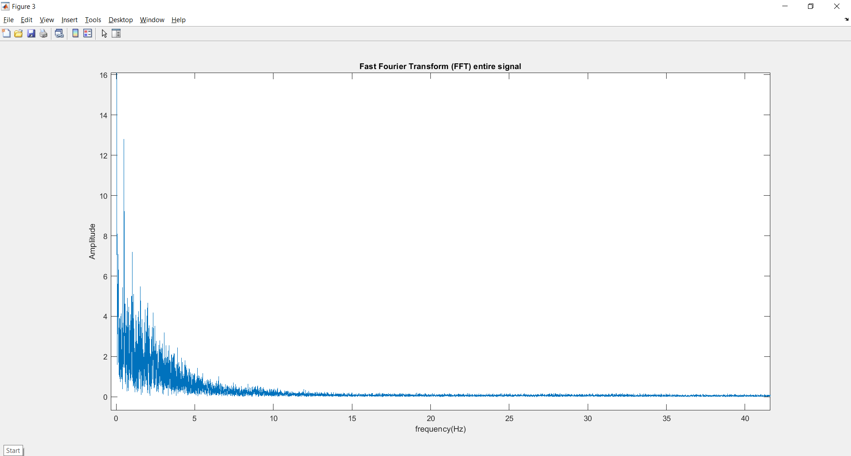
Whole Signal FFT
Signal 2 FFT
Top - full output
Bottom - zoomed in
Detrending the whole data has made it more consistent but not really changed the FFT

Slide 6
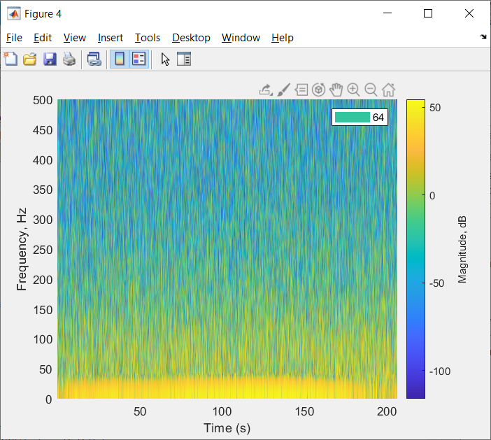
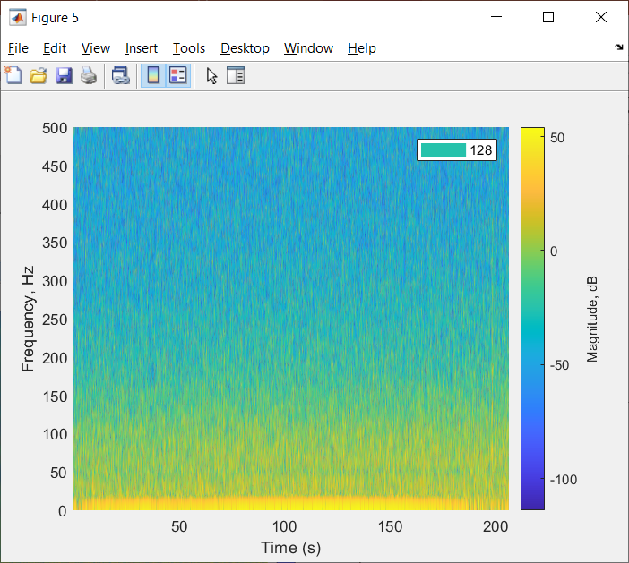

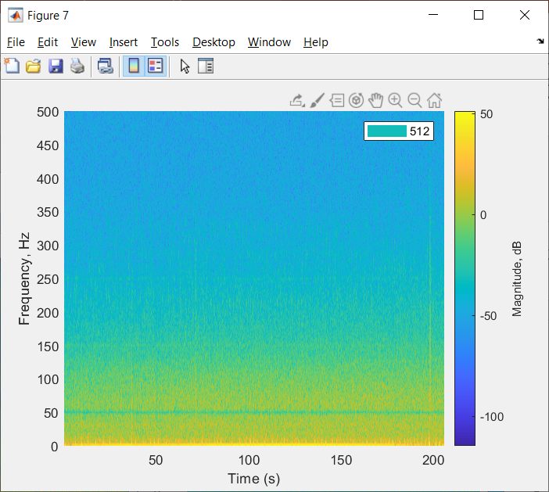
STFT signal 1

Slide 7
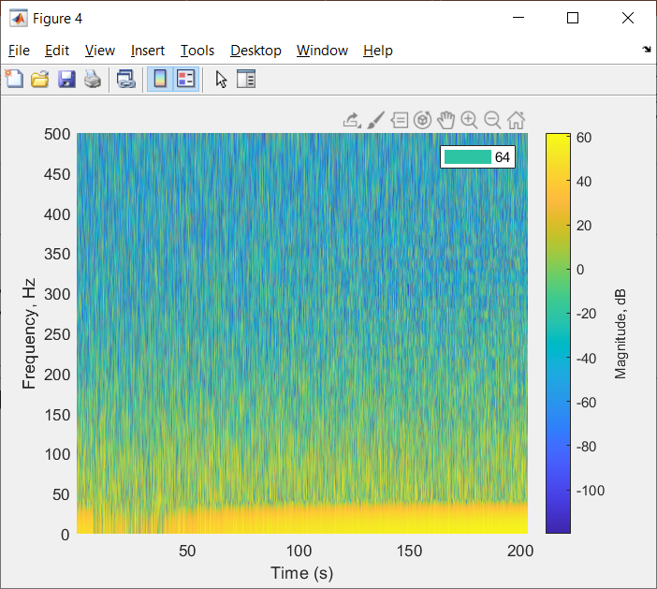
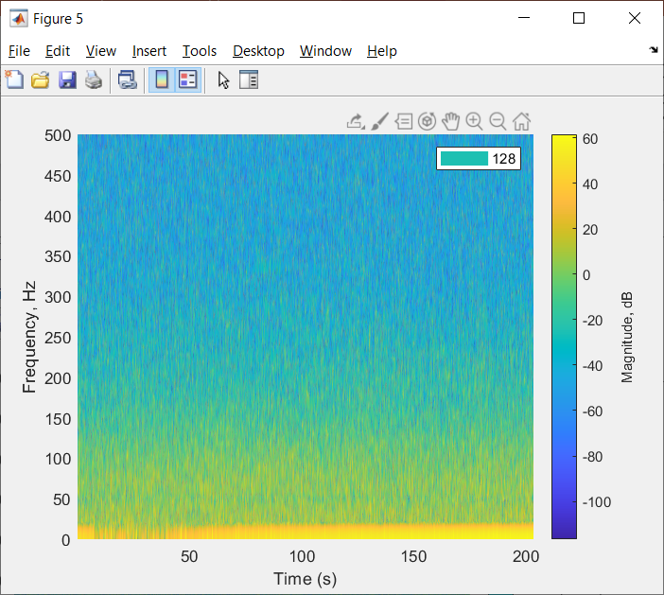
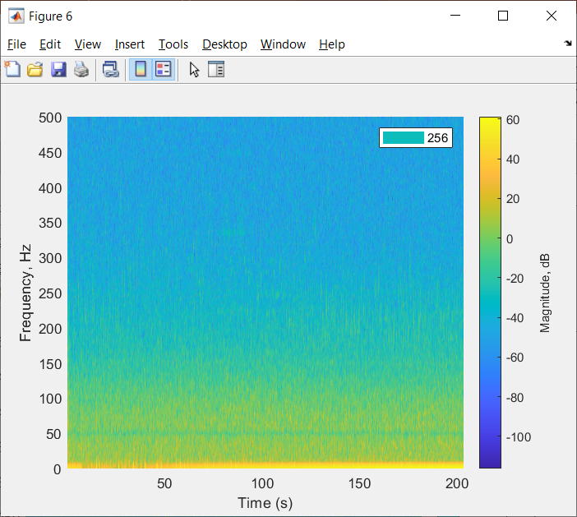
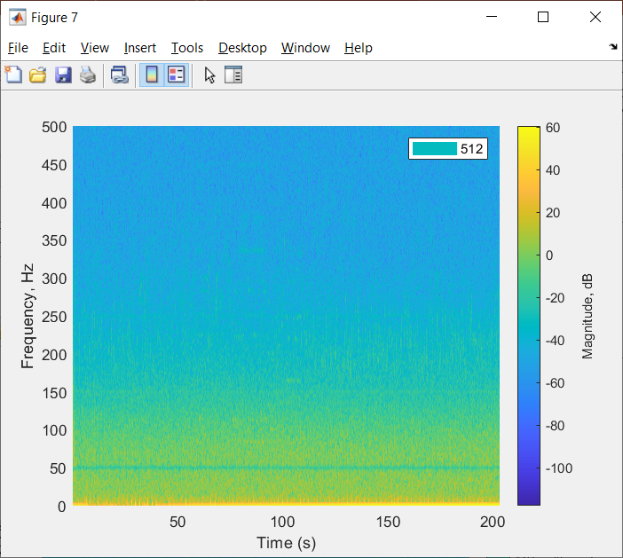
STFT signal 2

Slide 8
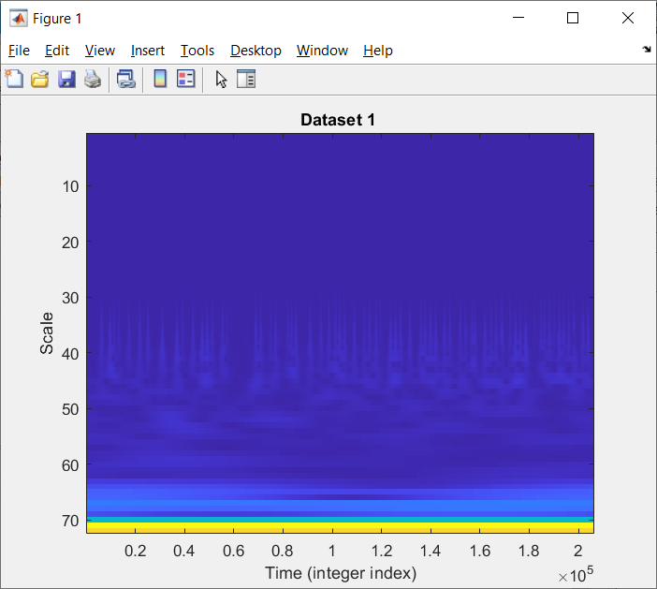
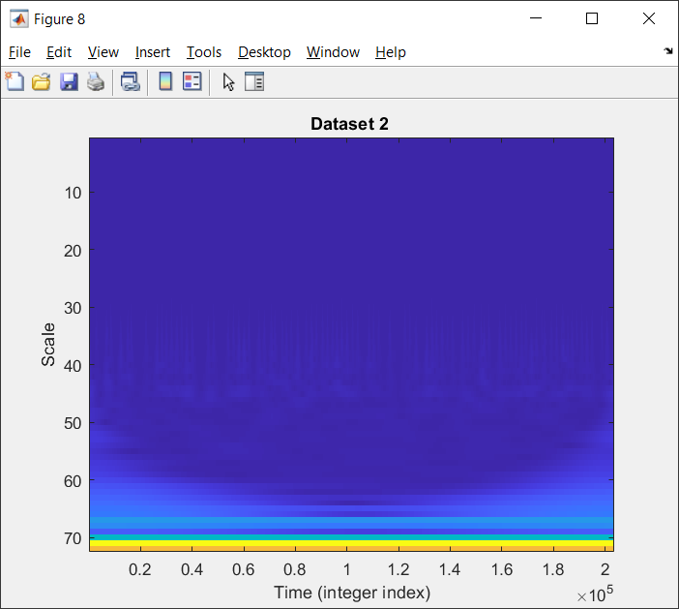
Continuous Wavelet Transform CWT

Slide 9
Window based method
Tried 2 sizes:
1024 window with 512 step
2048 window with 1024 step
Applied detrending to the entire signal
Applied detrending to both the entire signal and the event
2 variations:
0 point (mean)
9 point polynomial
No detrend but same time periods for both frame sizes on the next 2 slides

Slide 10
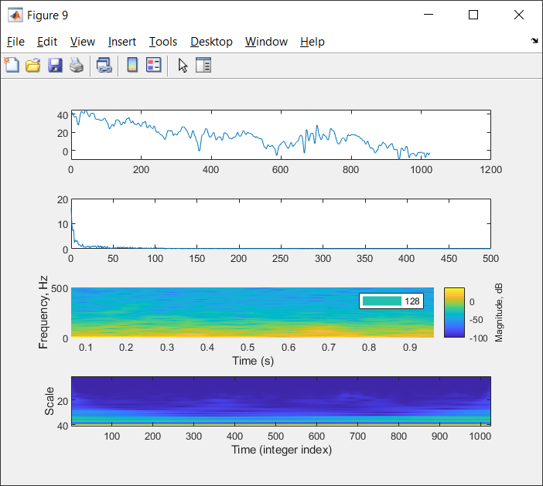
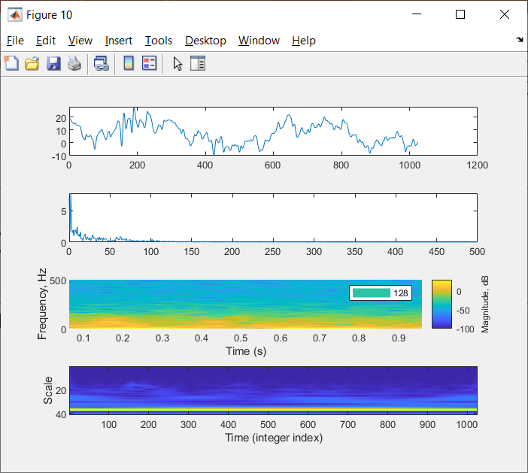
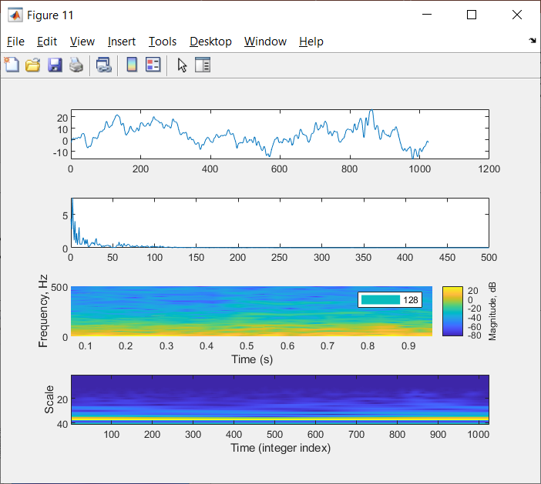
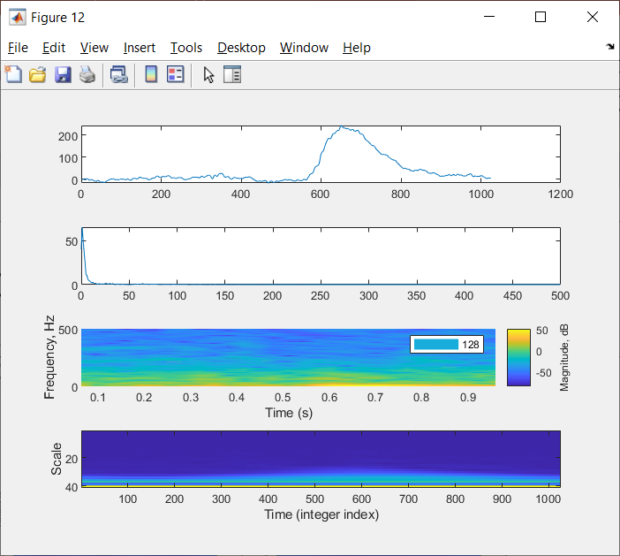
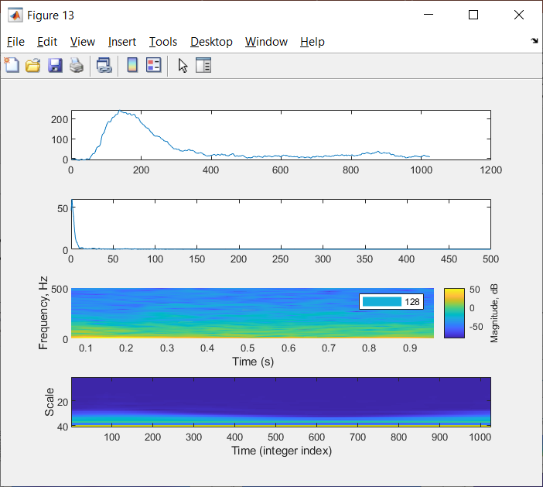
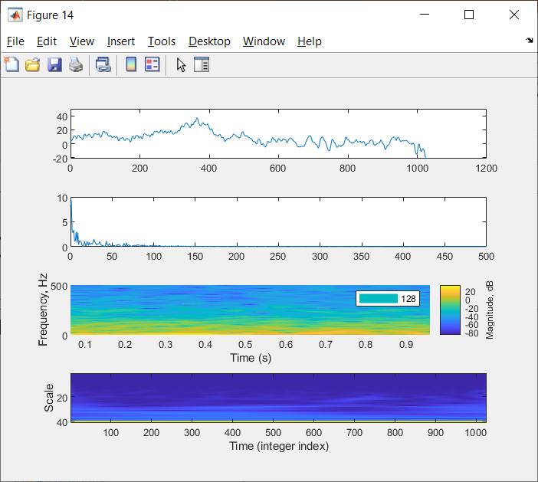

Slide 11
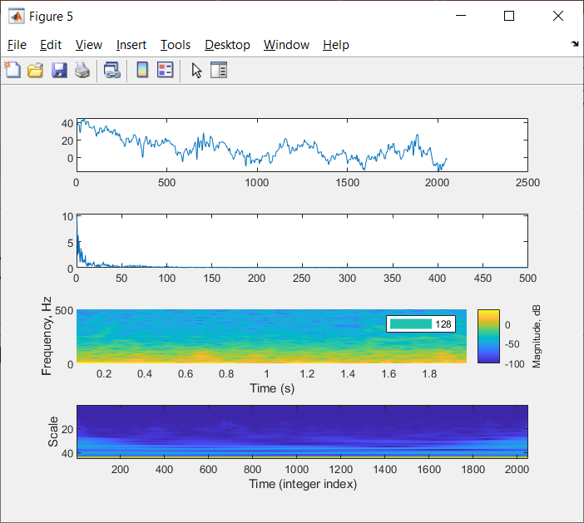
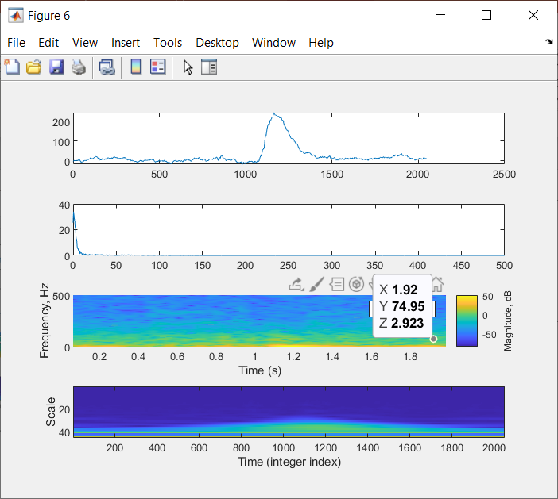
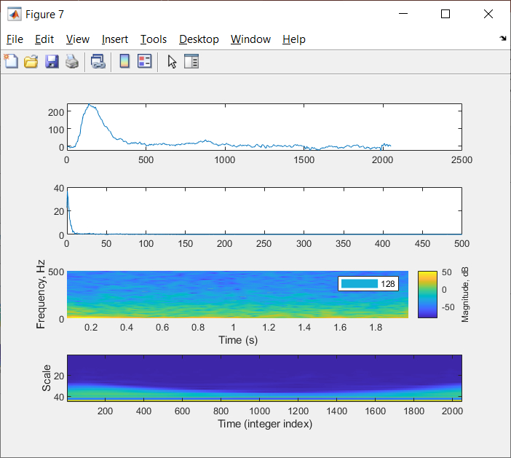
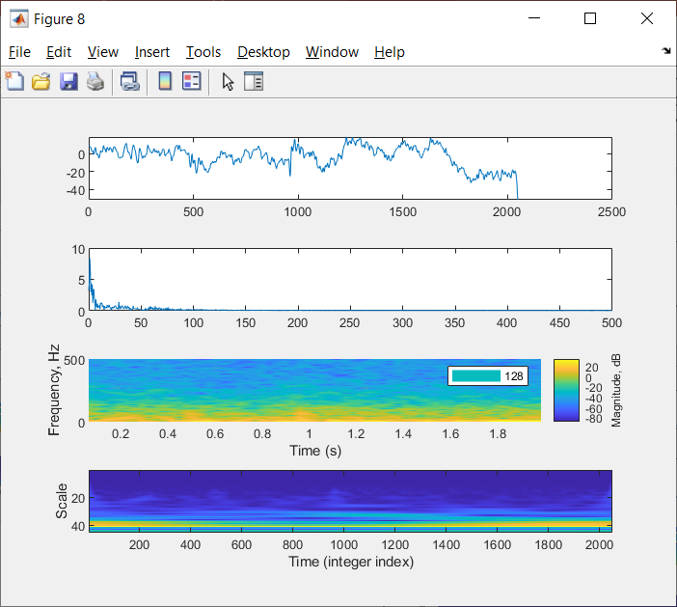

Slide 12
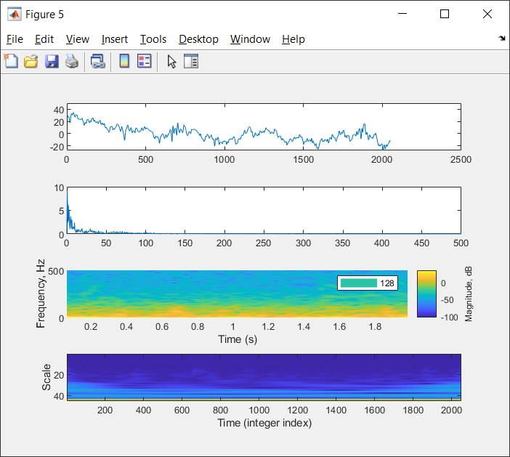
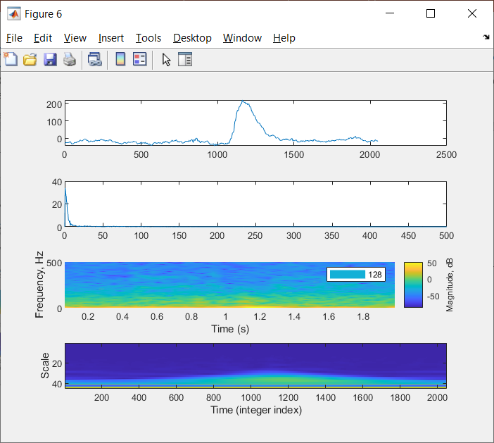
Little to no change for 0 point detrend

Slide 13
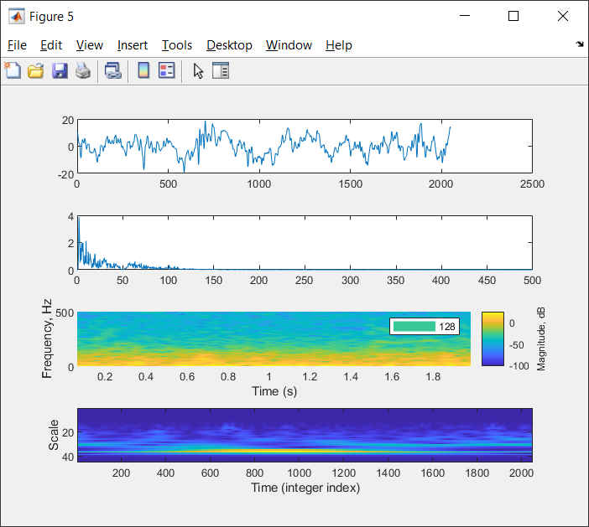
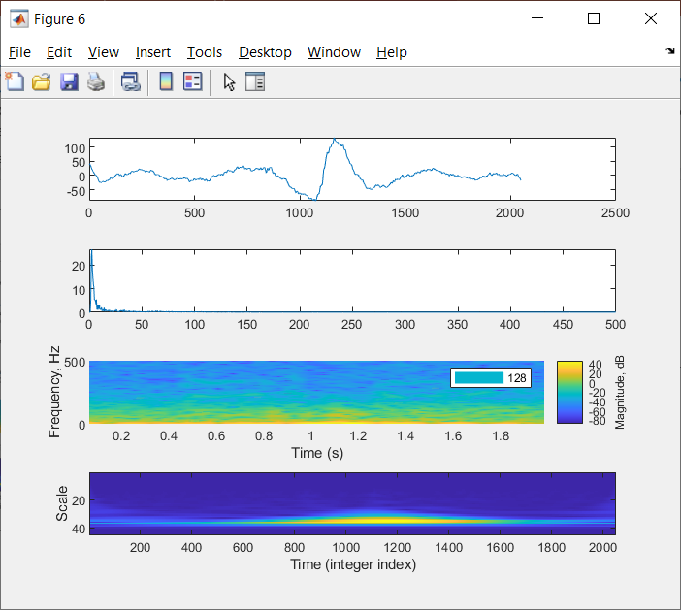
Large change for the raw signal, Fast Fourier and wavelet for the 9 point detrend
In each case there is a difference in event and non event slides that can be shown immediately from the window

